Slide 1

Air Bnb Hotel Booking Analysis
Devansh Verma
STU679cddefaa31e1738333679

Slide 2

PROBLEM STATEMENT
the need to understand the dynamics of Airbnb bookings as the platform grows in listings and users. Specifically, the challenge is to analyze Airbnb hotel booking data to uncover patterns, trends, and insights that can improve decision-making for hosts and enhance guest experiences. The goal is to identify the key factors that drive successful bookings and high guest satisfaction by examining booking behaviors, pricing strategies, guest preferences, and host performance.

Slide 3
Project Description
This project focuses on analyzing Airbnb listing data to uncover patterns and insights that can help hosts, guests, and platform managers optimize their experiences and operations. Using a combination of statistical analysis, machine learning, and data visualization techniques, the project investigates key factors such as pricing strategies, guest review rates, host behaviors, and availability trends.
Data is explored from various dimensions, including geographical location, room type, and host verification status. The study uses correlation analysis, regression modeling, and group comparisons to answer questions about which neighborhoods have the most listings, which groups command the highest prices, and what factors affect guest satisfaction and property availability.
Advanced analytics are implemented, such as predictive modeling for future pricing and demand, dynamic recommendation systems based on guest preferences, and geospatial analysis to understand the influence of location. External data sources, such as weather and local events, are suggested for integration to further enhance result accuracy. The objective is to provide actionable recommendations for dynamic pricing, personalized suggestions, and improved market understanding, supporting both strategic planning and operational decisions in the hospitality industry.

Slide 4

WHO ARE THE END USERS?
The end users of this project are primarily:
Airbnb Hosts: They can use the insights and predictive tools developed to optimize their pricing strategies, manage availability, and understand guest preferences for better bookings and reviews.
Airbnb Guests: They benefit from improved, personalized recommendations and potentially fairer, dynamic pricing based on their behaviors and preferences.
Platform Managers and Analysts: Airbnb staff can leverage the models and analytics for market analysis, regional performance tracking, and platform-level decision-making to improve service offerings and competitiveness.
Hospitality Industry Researchers: Researchers and consultants interested in market trends, guest-host relationships, and pricing dynamics can use the findings for deeper analysis and reporting.

Slide 5

Technology Used
Python: The primary programming language for data analysis and model development.
Pandas: For data manipulation and cleaning of large datasets.
NumPy: For efficient numerical computations and array handling.
Matplotlib & Seaborn: For creating data visualizations, plots, and graphs to analyze trends and relationships.
Scikit-learn: For machine learning tasks such as predictive analytics, regression, and clustering.
Jupyter Notebook: For interactive analysis and documenting the workflow in a reproducible format.

Slide 6
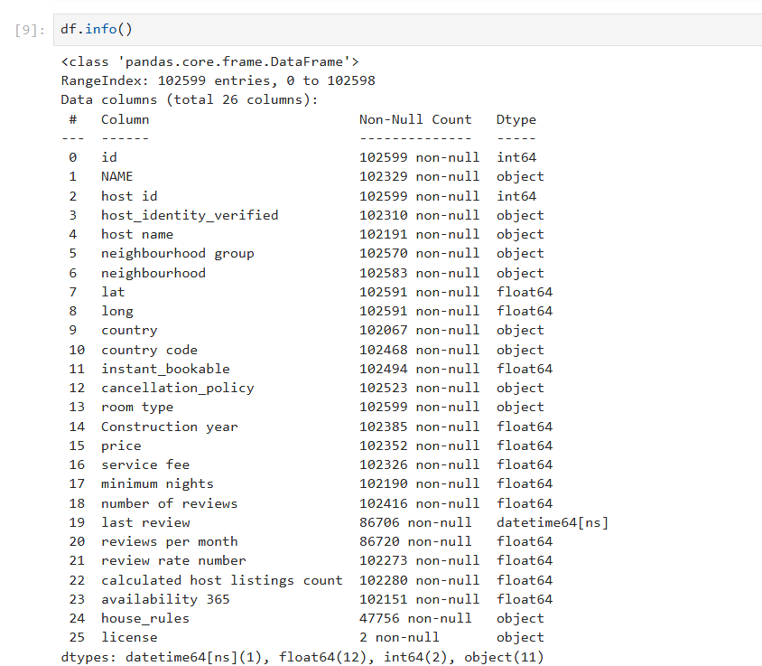
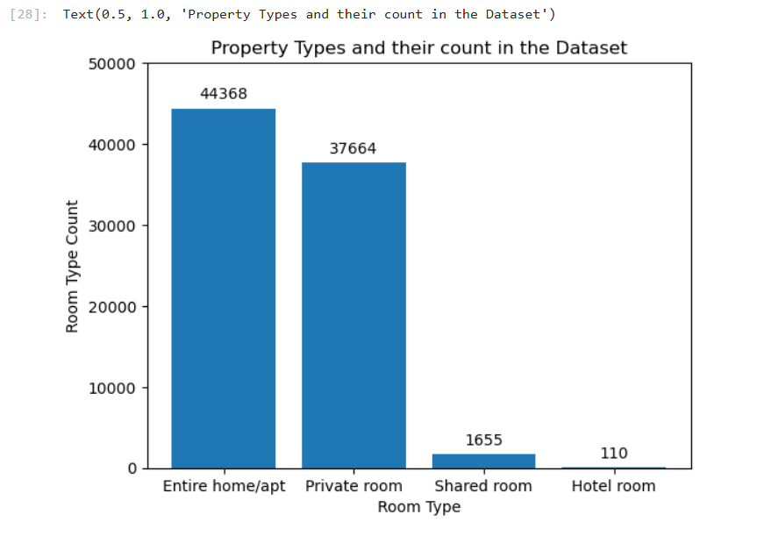
RESULTS1
Demo Link

Slide 7
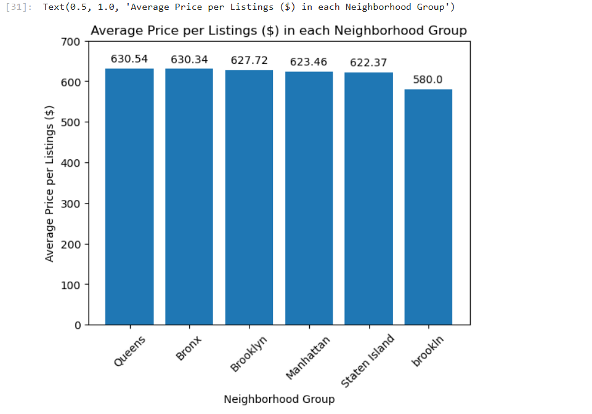
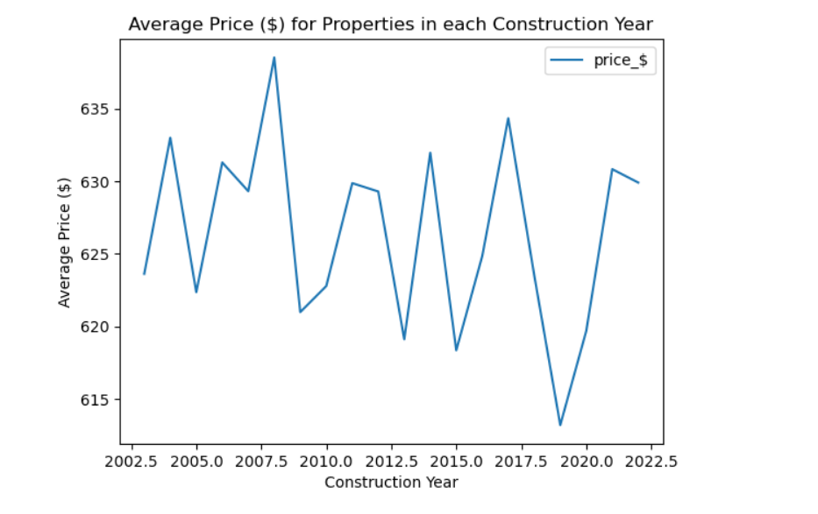
RESULTS2

Slide 8
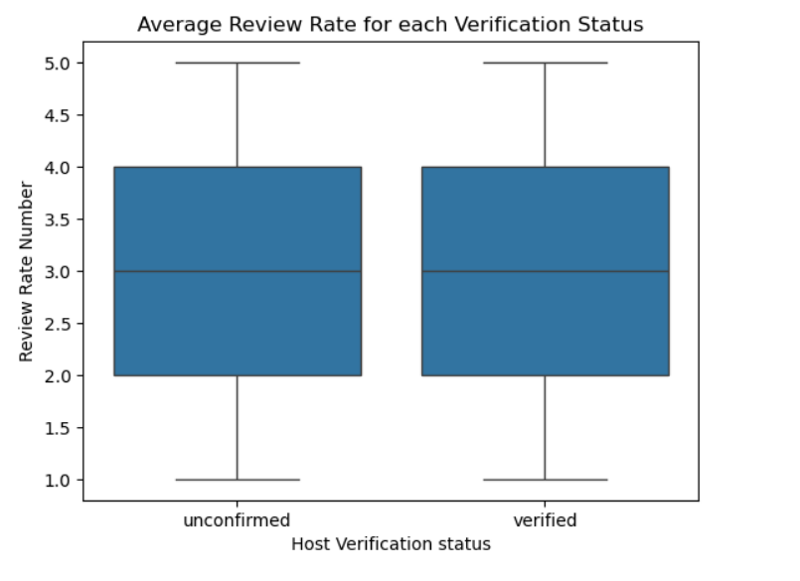
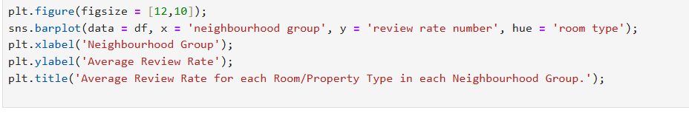
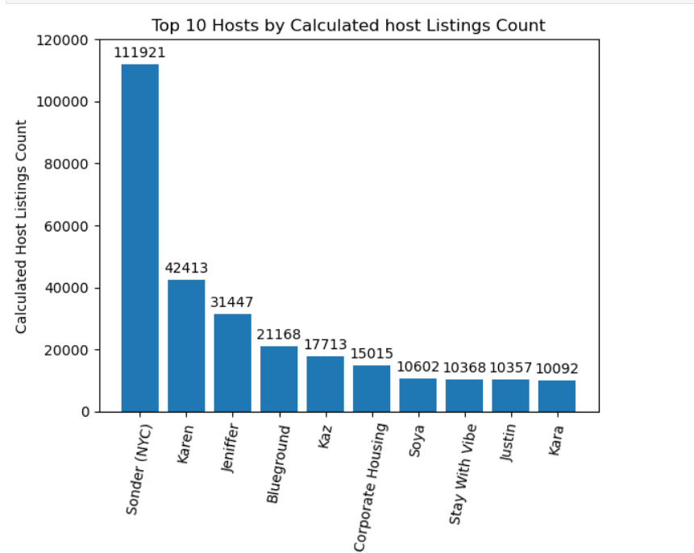
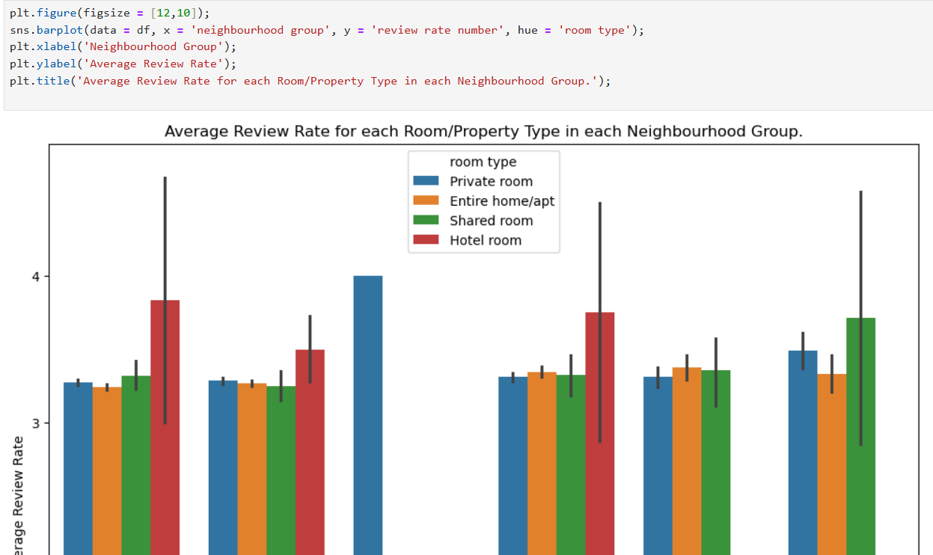
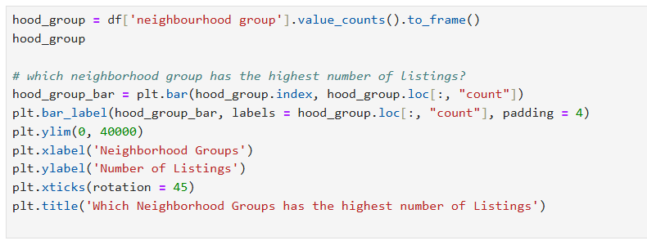
RESULTS3

Slide 9
GitHub repository
https://github.com/Devansh0009/VOIS_AICTE_Oct2025_Devansh-Verma.git
Demo Link

Slide 10
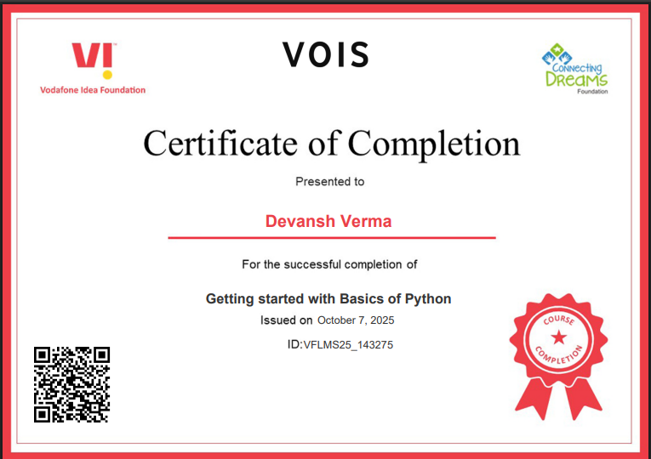
Getting started with Basics of Python Certificate

Slide 11
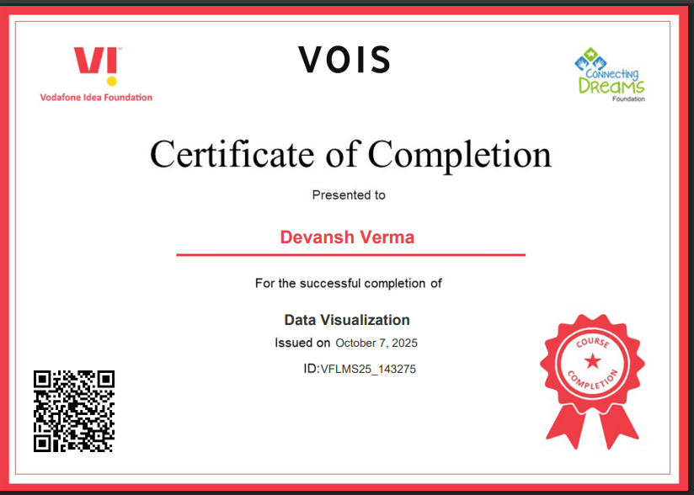
Data Visualization Certificate

Slide 12
Thank you
.
.

